Slide 1

Image Classification Model Project
Submitted By: Rahul Singh

Slide 2
Introduction:
Image classification Project is a deep learning-based Image Classification model project.
This model is basically build by downloading multiple product images from amazon website using selenium automation tools.
Image classification model is used to predict the type of image when it passes through model.
The model is build by using InceptionV3 and then using tensorflow library.

Slide 3
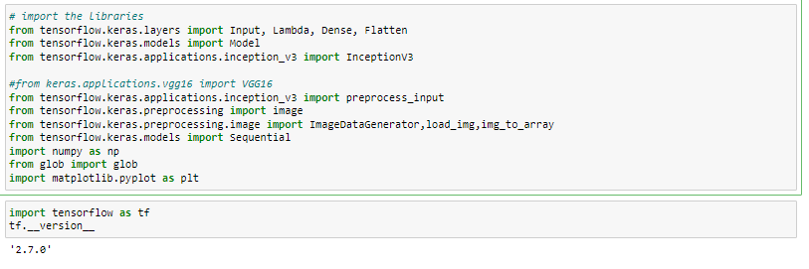
Importing Libraries:
Importing the Libraries used for EDA, data preprocessing and model building.

Slide 4
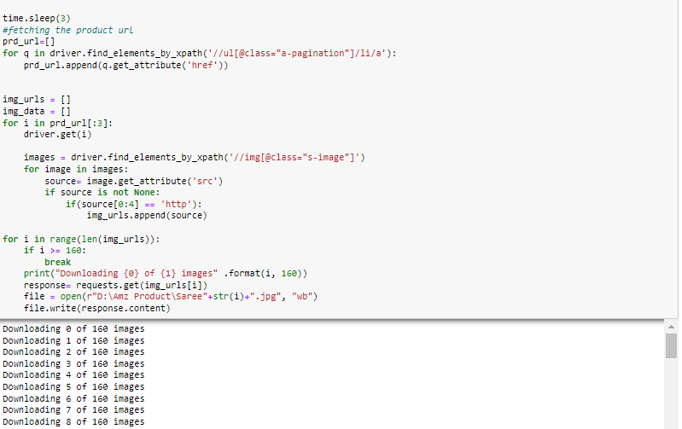
Using Selenium to fetch the Data:
Selenium Web driver is used to download the image from amazon website for multiple products.

Slide 5
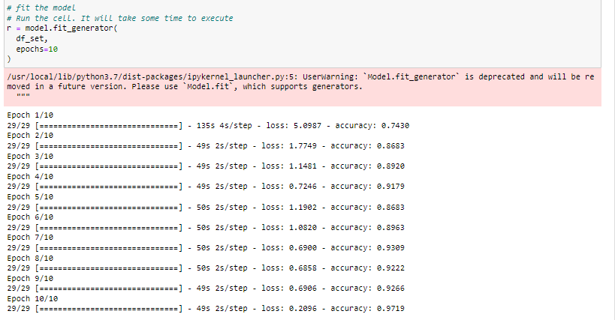
Building the model:
Using the NPL and Deep learning to build the model and using tensorflow library to build the model.

Slide 6
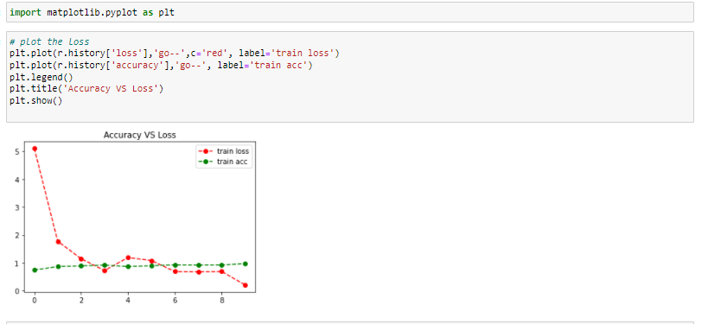
Checking Accuracy vs loss graph:
Plotting the matplot graph to check accuracy vs loss graph.

Slide 7
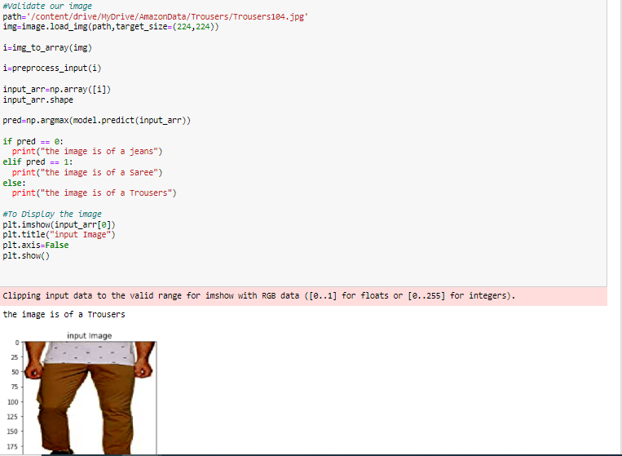
Model Validation:
Using model validation method to validate the image and test the model.

Slide 8

Saving the Model:
After the hyper parameter tuning saving the final model in the hs file.
This complete the model building.

